Slide 1


Slide 2
Team Leader – Luke (Red Ranger)
Followed Exercises

Slide 3

Red Ranger’s Analysis

Slide 4
Green Ranger’s Analysis

Slide 5
Blue Ranger’s Analysis

Slide 6
Yellow Ranger’s Analysis

Slide 7
Black Ranger’s Analysis

Slide 8
Hive vs. Impala

Slide 9
Issues
Didn’t read readme file
Syntax
Genre not added to movie file – didn’t understand 000111s
Issues with terminated by ‘|’ ‘\t’ – spaces ..
Issues with file permissions in impala write – chown –R to resolve
Udtf – user defined table functions not supported outside select clause in hive – What is it????

Slide 10

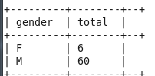
How many female programmers?

Slide 11
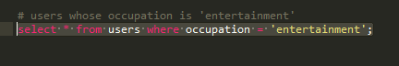
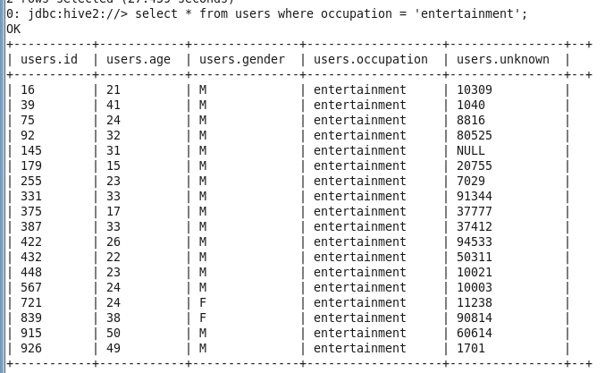
Users who work in the Entertainment Industry

Slide 12
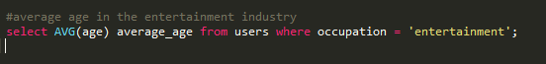
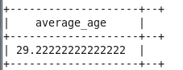
Average of users working in Entertainment Industry

Slide 13
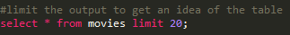
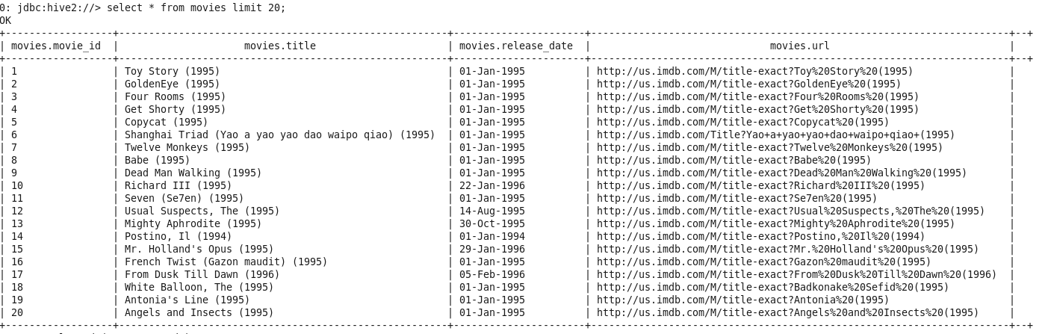
Limit the output to 20
Why should you limit your results?
Many analysts use limits as a simple way to keep their queries from taking too long to return. The aim of many of your queries will simply be to see what a particular table looks like—you’ll want to scan the first few rows of data to get an idea of which fields you care about and how you want to manipulate them. If you query a very large table (such as one with hundreds of thousands or millions of rows) and don’t use a limit, you could end up waiting a long time for all of your results to be displayed

Slide 14
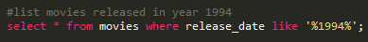
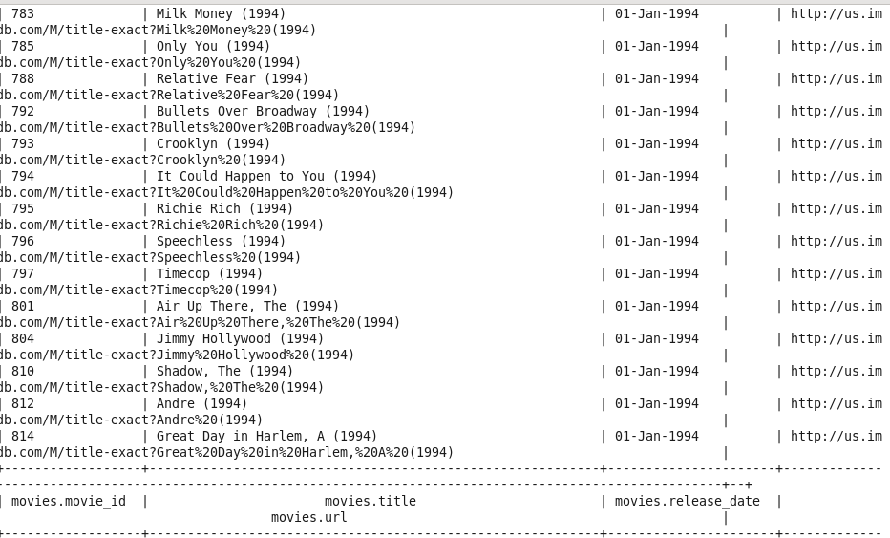
List all movies released in 1994

Slide 15
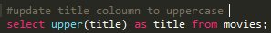
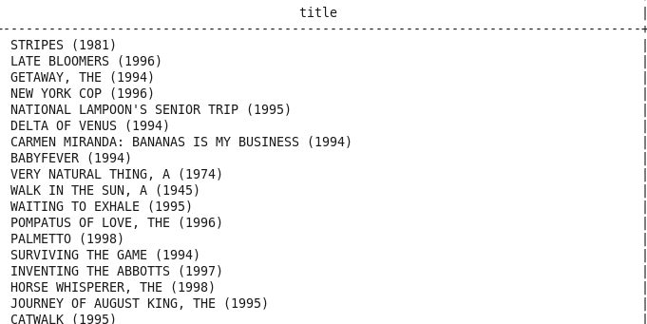
Change title column record to uppercase

Slide 16
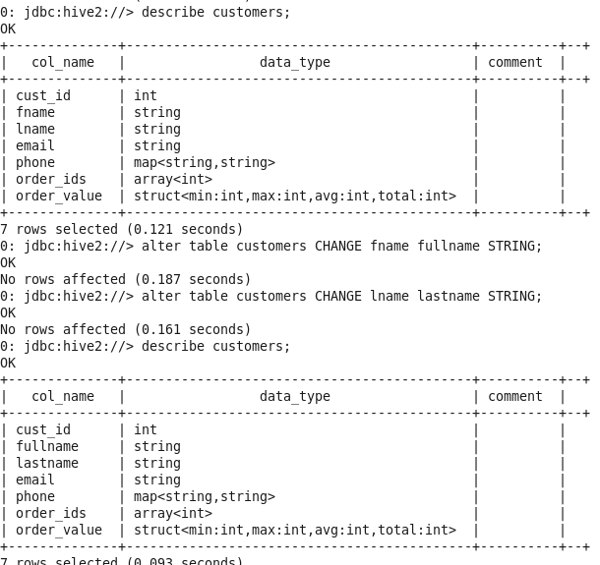
Exercise 3 Alter col Names

